Slide 1
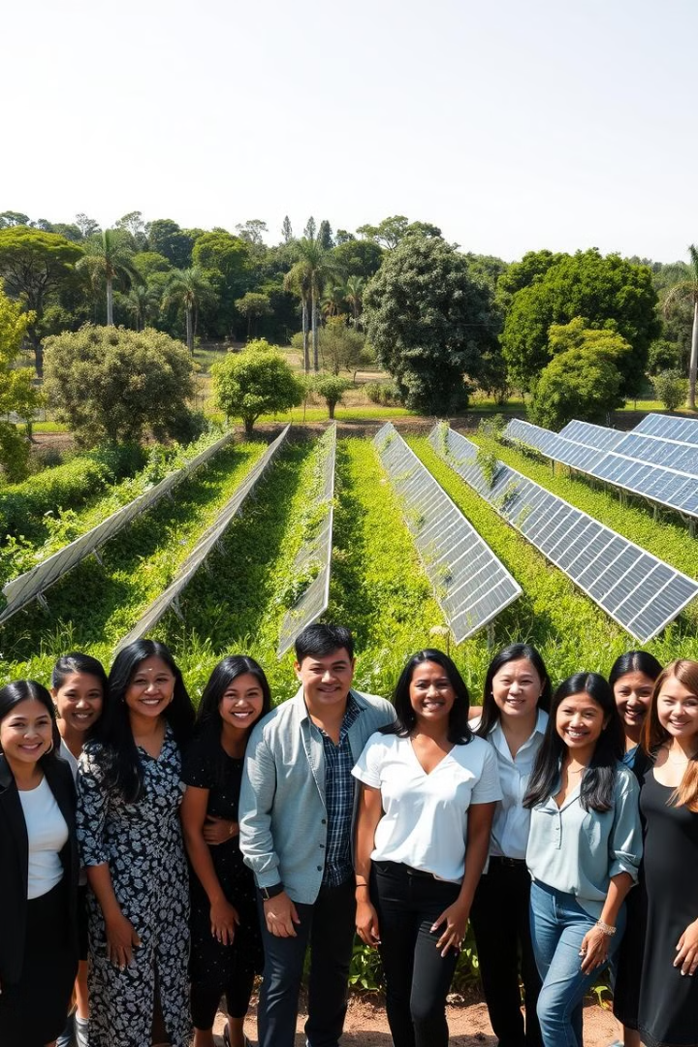

Topic of the Project
This project aims to address the pressing issue of climate change through a multifaceted approach, focusing on renewable energy, reforestation, and community engagement.
by Dr. Satish Kumar

Slide 2
Project Abstract
Overview
Key Objectives
Approach
This project combines innovative renewable energy technologies, large-scale reforestation efforts, and community-driven initiatives to create a comprehensive solution to address climate change.
Reduce greenhouse gas emissions, increase carbon sequestration, and empower local communities to adopt sustainable practices.
Integrate solar, wind, and energy storage systems; plant trees and restore degraded ecosystems; and engage with stakeholders to drive behavior change.

Slide 3

Project Goals and Objectives
Renewable Energy
1
Implement large-scale solar and wind power generation to provide clean, sustainable energy to local communities.
2
Reforestation
Restore degraded ecosystems and plant millions of trees to increase carbon sequestration and biodiversity.
Community Engagement
3
Empower local communities to adopt sustainable practices and serve as advocates for climate action.

Slide 4
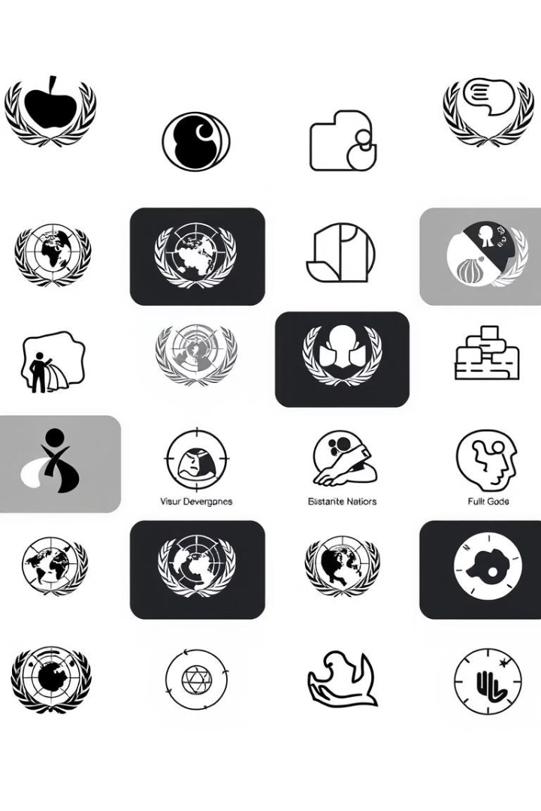
Alignment with UN Sustainable Development Goals (SDGs)
SDG 7: Affordable and Clean Energy
SDG 13: Climate Action
Take urgent action to combat climate change and its impacts.
Increase the share of renewable energy in the global energy mix.
SDG 15: Life on Land
SDG 17: Partnerships for the Goals
Protect, restore, and promote sustainable use of terrestrial ecosystems.
Strengthen global partnerships to support and achieve the SDGs.

Slide 5





Methodology and Approach
Data Analysis
Conduct comprehensive assessments of renewable energy potential, carbon sequestration capacity, and community needs.
Technology Integration
Deploy advanced solar, wind, and energy storage technologies to maximize clean energy generation.
Ecosystem Restoration
Implement large-scale reforestation and land restoration efforts to enhance carbon sinks.
Community Empowerment
Engage with local stakeholders to drive sustainable behavior change and foster ownership of the project.

Slide 6




Expected Outcomes and Impact
Renewable Energy
Carbon Sequestration
Community Empowerment
Significant increase in renewable energy capacity, reducing reliance on fossil fuels.
Substantial increase in carbon sequestration through large-scale reforestation.
Empowered local communities actively participating in climate change mitigation efforts.

Slide 7
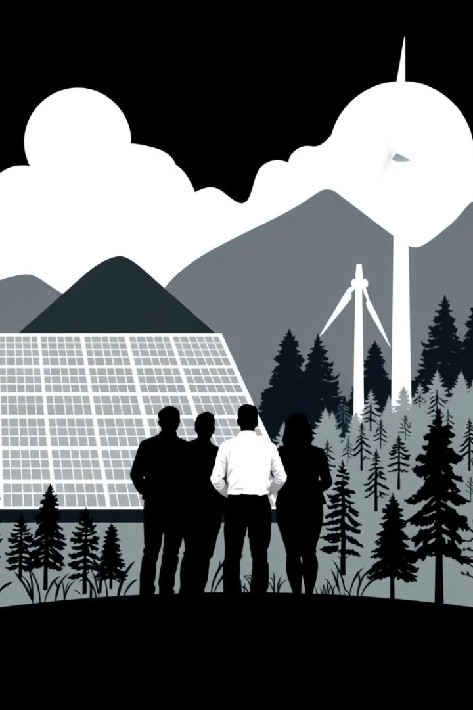
Key Project Deliverables
Renewable Energy Systems
Large-scale solar and wind power installations
Reforestation Efforts
Planting of millions of trees and restoration of degraded ecosystems
Community Engagement
Workshops, educational programs, and advocacy campaigns

Slide 8
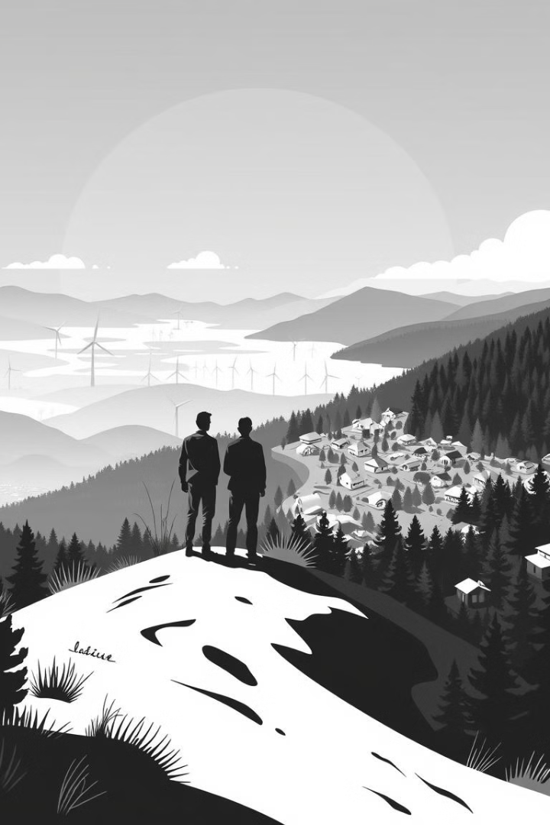
Next Steps and Conclusion
1
Scale and Expand
2
Forge Partnerships
Replicate the successful model in other regions and continue to grow the project's impact.
Collaborate with government, private sector, and civil society to further strengthen the initiative.
3
Monitor and Evaluate
Continuously assess the project's performance and make adjustments to optimize its effectiveness.

